Slide 1
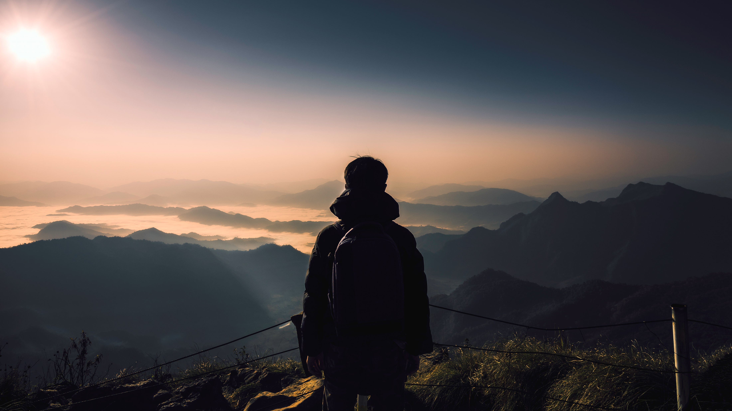
Presentation on Tourism in India
From
Daksh Gambhir
Sumit Vishwakarma
Manjeet Yadav
Simar Singh
Angad Soni
Manit Chopra

Slide 2
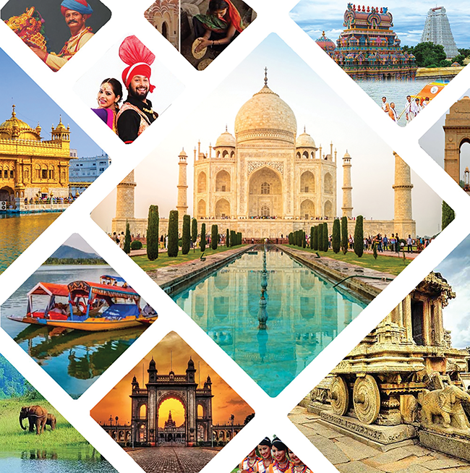
Introduction
From the Himalayas in the north to the beaches of Goa and the backwaters of Kerala, India is a top global tourist destination.
India ranks among the top countries in cultural and historical tourism.
Over 17 million international tourists visited India in 2019.
The sector provides employment to over 42 million people.

Slide 3
Challenges and Problems in Tourism
Pollution & Cleanliness: Many tourist spots face pollution issues.
Safety Concerns: Reports of tourist harassment and scams.
Unregulated Tourism: Overcrowding and environmental damage.

Slide 4
Biggest Industry
India’s tourism industry is worth over $247 billion.
Employs over 40 million people, directly and indirectly.
Major sectors include heritage tourism, adventure tourism, medical tourism, and eco-tourism.
Domestic tourism is growing rapidly, with over 1.8 billion trips annually.

Slide 5
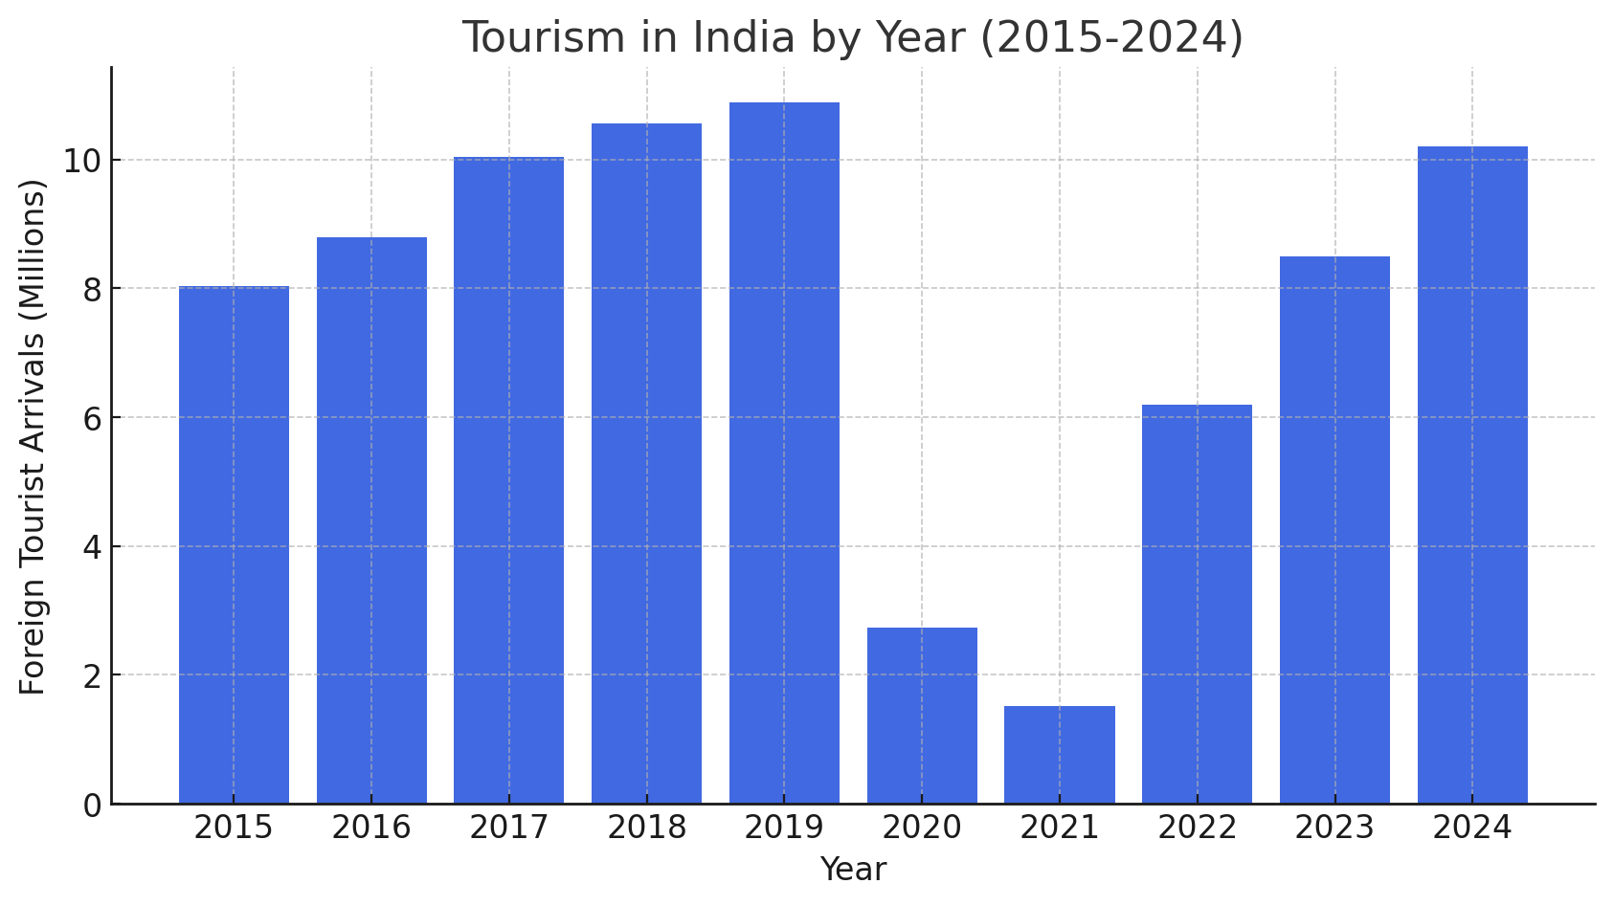
A steady rise in tourism from 2015 to 2019.
A sharp decline in 2020-2021 due to COVID-19.
A gradual recovery in 2022, with estimated increases in 2023 and 2024.

Slide 6
Tourist Attractions
Historical Monuments: India is home to iconic landmarks like the Taj Mahal, Qutub Minar, and Red Fort, reflecting its rich cultural heritage.
Spiritual Destinations: Sacred sites like Varanasi, the Golden Temple, and Rishikesh attract millions seeking peace and devotion.
Natural Wonders: The serene Kerala backwaters, majestic Himalayas, and biodiverse Sundarbans showcase India's stunning landscapes.
Beaches & Islands: Goa, Andaman & Nicobar, and Lakshadweep offer pristine beaches and tropical getaways for relaxation and adventure.

Slide 7
Government Initiatives
Incredible India– Promotes India’s tourism globally.
Swadesh Darshan Scheme – Develops theme-based tourism circuits.
PRASAD Scheme – Focuses on religious and heritage tourism.
E-Visa Facility– Available for 170+ countries, boosting foreign tourism.
Dekho Apna Desh – Encourages domestic travel among Indians.

Slide 8
Summary
India has immense tourism potential with its rich heritage and natural beauty.
Addressing infrastructure and safety concerns can further boost the industry.
Government efforts and private investments are crucial for sustainable tourism.

Slide 9

Thank you

